Slide 1
iPOM and E-Booking

Slide 2
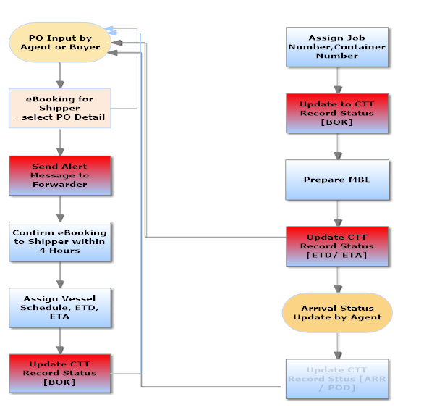
IPOM
CTT

Slide 3
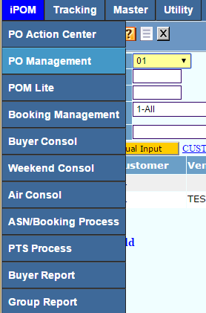
Upload Purchase Order - Intended User are Forwarder or Customer to Upload Their Own Files.
PO Management -> Press [ go ] to see the PO Records
Press [ + ] to create a new PO record

Slide 4
Upload Purchase Order
Select Customer Code, e.g “01”
Click Customized purchased order to Download a sample to your PC
Click Excel Template to Download a sample to your PC

Slide 5
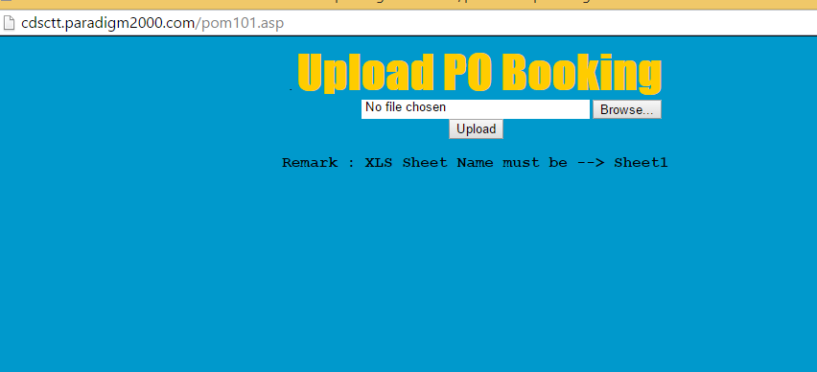
Upload Purchase Order
User could sample to add PO Number
Once New PO Number is in place, Save Your File.
Click Upload Excel To Upload the New PO File
Use The Browse to look for your saved PO File, Once Selected, Click Upload to
System Would Prompt You To Refresh Data, Click OK. New PO Record Uploaded, you could proceed with PO Management

Slide 6
PO Management - Intended Users are Forwarders To Manage all Customers PO, Query by PO Number and down to PO Items, and Status. User Can Always obtain an Excel Report during Query. We would configure the System For Customer to Manage their own PO as well.
PO Management - Manage all Customers PO, Query by PO Number, Customer, Vendor, and PO Status by clicking blue bulb
Query method can be at item level also

Slide 7
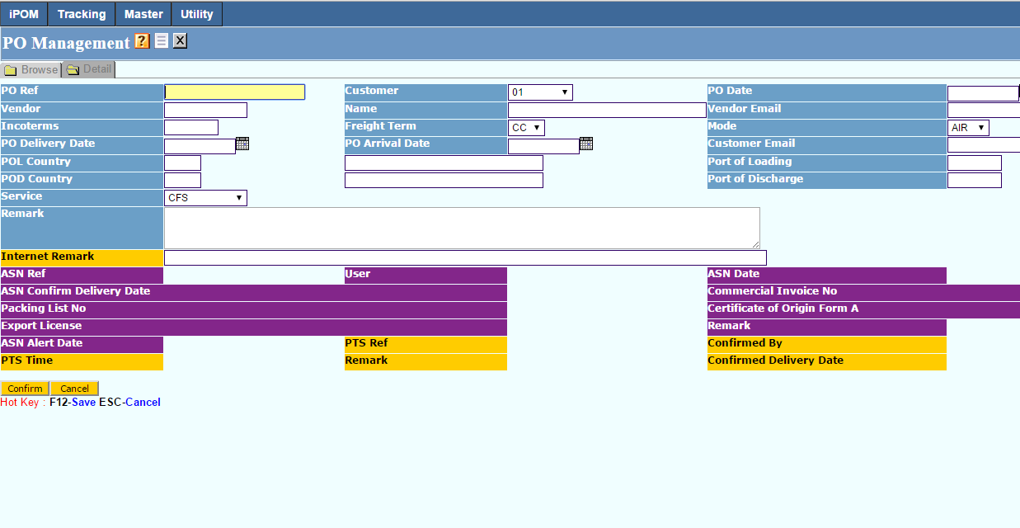
PO Management basic Information
Input Shipper / Consignee information. If you press a key and press down arrow, the system will try to see if you have the master file created.
PO reference , PO Date and PO delivery date are mandatory fields. Others are optional.
Press [ Confirm ] to create the basic PO information

Slide 8
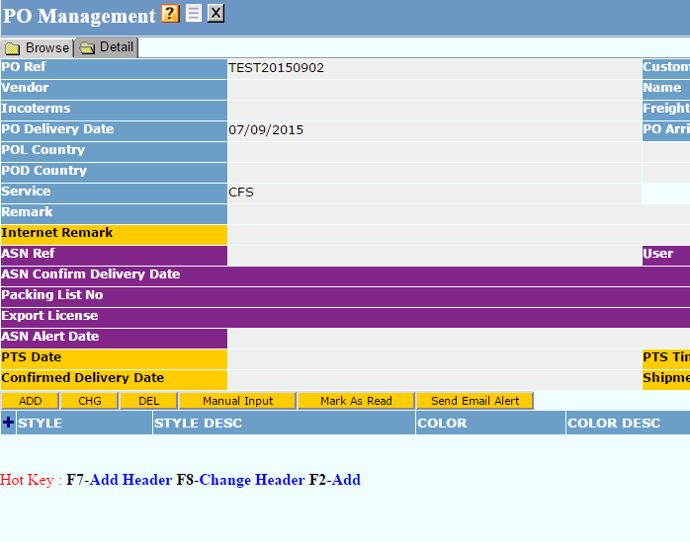
PO Management basic Information
Once it is done, you can see the button.
Press Manual Input or the [+] to create the PO Detail.

Slide 9
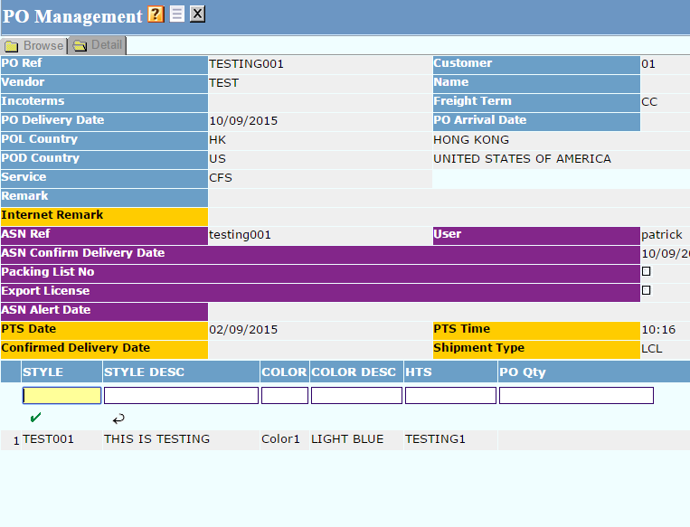
PO Management detail
Input the Style, Style Description, PO Qty ETC if you have the information
Press [ √ ] to save
User can continue to add other items

Slide 10
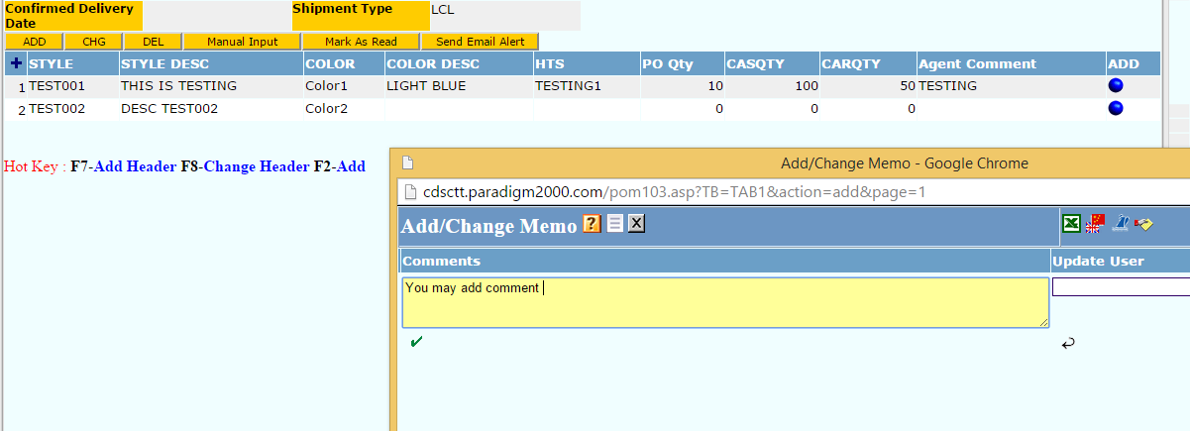
PO Management detail
Once the PO item is input, you can see the blue bulb.
Click the bulb and you can press [+] to add comment, press [ √ ] to save

Slide 11
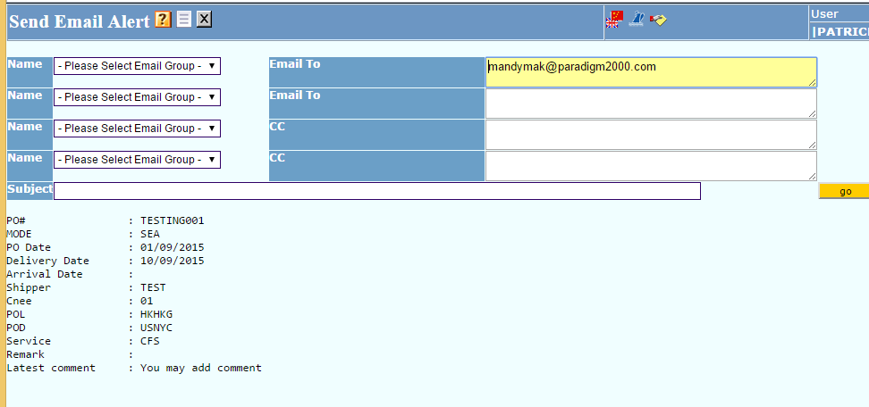
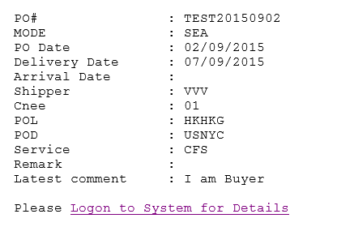
You can immediately send the chat content to the concern party.
Press [ go ] to send out this email and your partner can click the link and reply your concern.

Slide 12
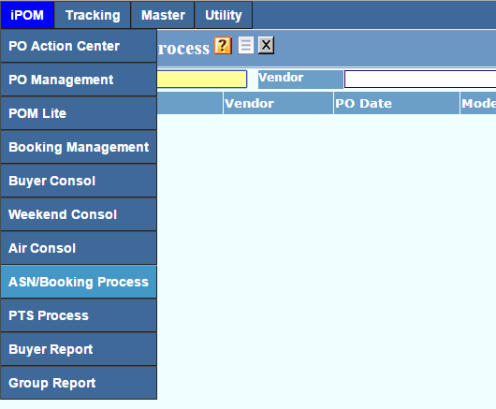
Advance Shipment Notice (ASN)- Intended Users are Vendor and Supplier
The following is for Vendor to Login system and process ASN manually.

Slide 13
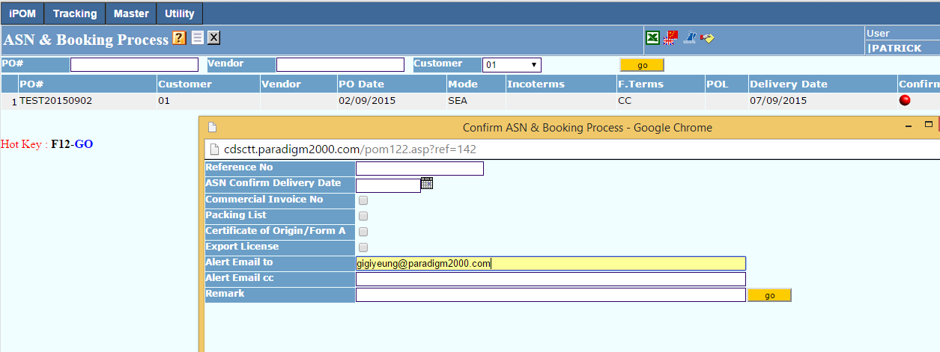
Advance Shipment Notice (ASN)
Can send email to alert Vendor, e.g 7 days in advance, by clicking Red bulb for a particular PO record that would enable Vendor to login to the system confirm the Shipment readiness. Upon completion, Vendor send email to Buyer or Forwarder to prepare for shipment. The Sending email processing could be automated.
User could specify what are documentation readiness, Package List and Invoice and send email to Buyer

Slide 14
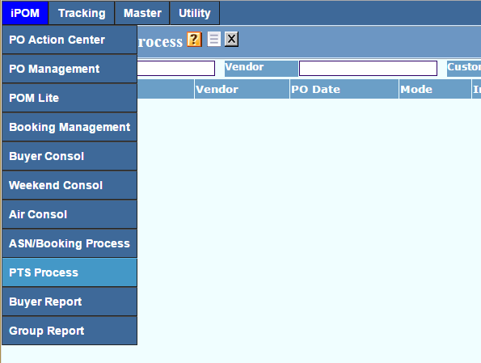
Permission To Ship (PTS) - Intended User are Buyer or Consignees
User would be notified via Email with a Hyperlink to a pre-set PO record for Processing.
User could also doing it manually and query their own PO status, and Obtain a report via Excel.

Slide 15
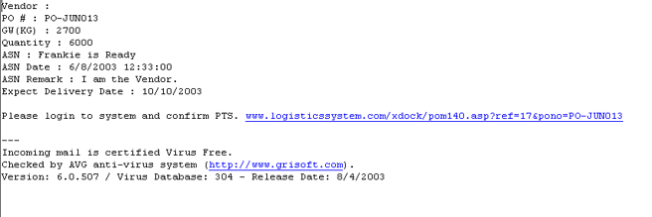
Permission To Ship (PTS)
Buyer will receive email and Click on the Link to access and update the PO record.
Buyer would be taken to the system, and view the PO information with detail. Buyer could click the Confirm button to confirm shipment go ahead.

Slide 16
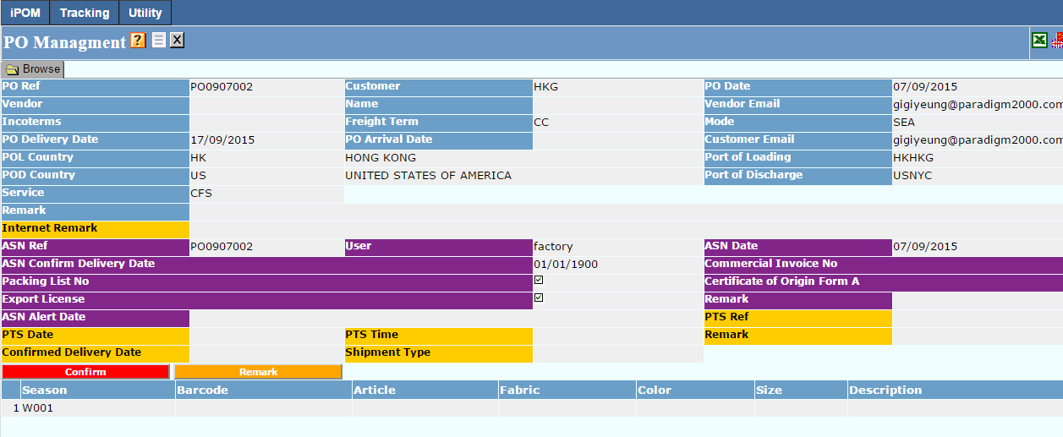
Permission To Ship (PTS)
Buyer would be taken to the system, and view the PO information with detail. Buyer could click the Confirm button to confirm shipment go ahead.

Slide 17
Permission To Ship (PTS)
Buyer input their approval number and remark

Slide 18
Booking Management
You can create eBooking record from the web directly.
Press [ go ] to check previous records
Press [ + ] to create new booking record.

Slide 19
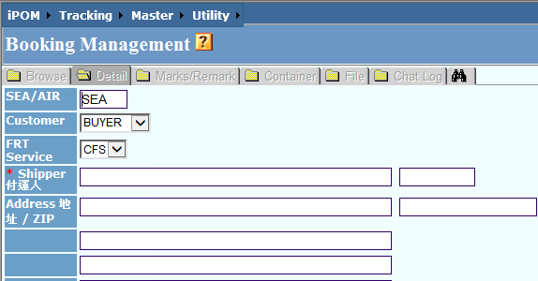
Booking Basic Information
First you must select AIR or SEA. If it is SEA, select the Freight Service CFS or CY

Slide 20
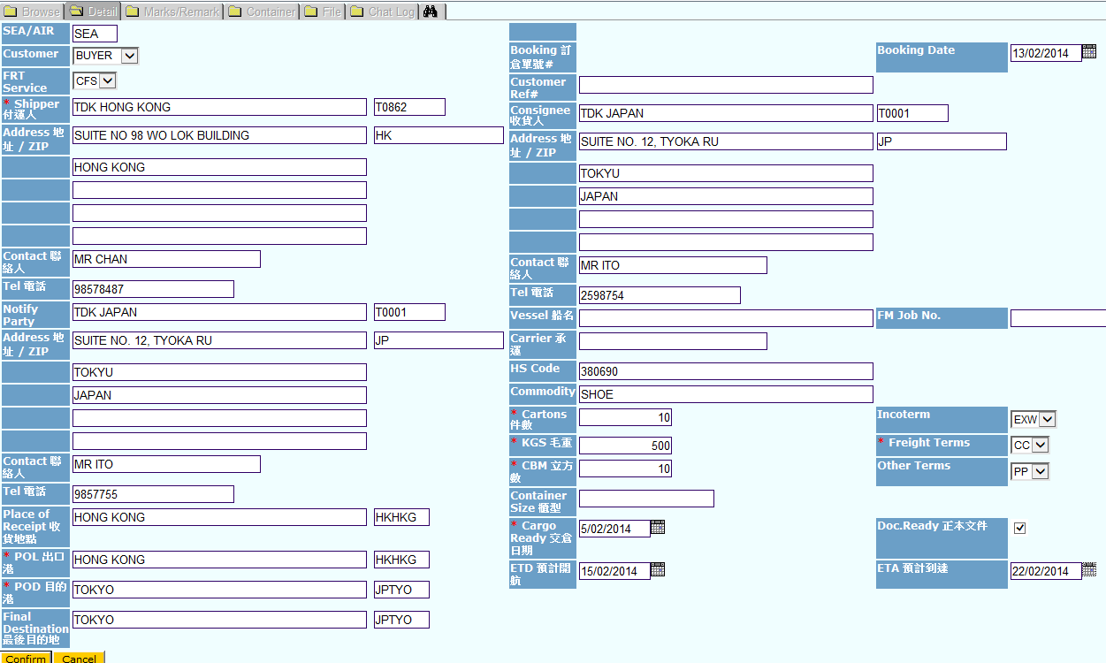
Booking Basic Information
User can input all the necessary information. The * are mandatory fields
Press [ Confirm ] to save

Slide 21
If the booking relates to previous PO files (Optional)
Once the booking basic information is input, press the button [Select iPOM ]

Slide 22
Booking Record Links to PO File (Optional)
Then you can see a screen for you to allow you to filter the required PO records, press [ go ]
Then you can see the PO records and tick the check box and press [ tick ]
The PO file is linked to this booking

Slide 23
Marks and Description
Click to the Marks/Remark
Click to the Marks and input the information. Press [ tick ] to save

Slide 24
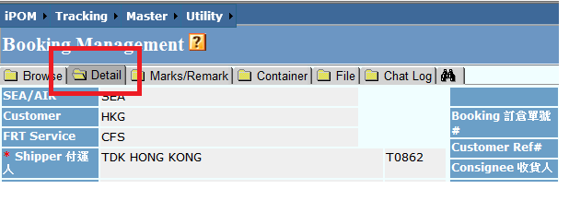
Submit Booking
Once it is done, go back to the Detail tag and press the button [ Submit Information ]
Customer service department will then receive the alert.

Slide 25
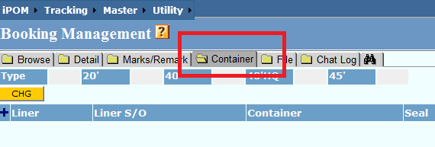
If it is CY Shipment
Go to the Container tag and press [+]
Input the information and * are the mandatory fields
Press [ tick ] to save

Slide 26
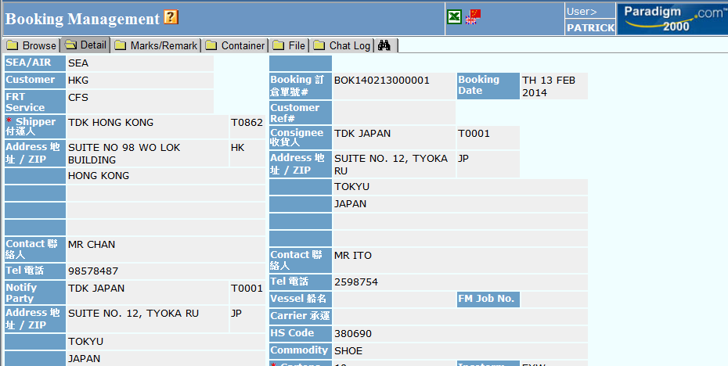
Check booking under POM Lite
You can check the information in PO File and the blue bulb will indicate that there is booking attached.
Click it and it will show the booking detail

Slide 27
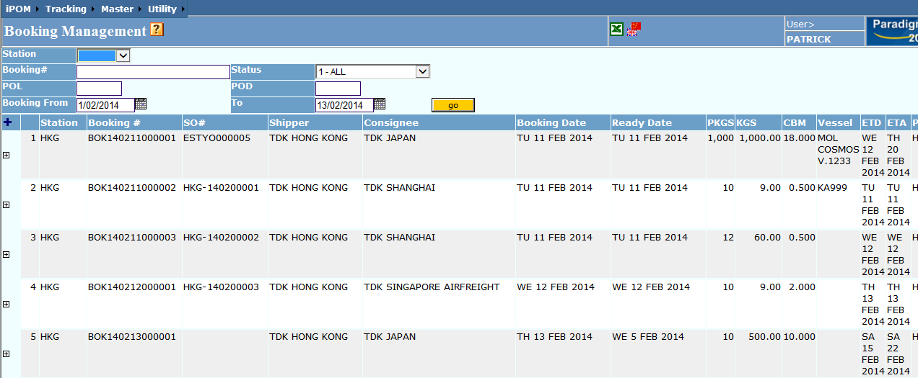
Check booking under Booking Management
If your booking did not carry any PO detail, input the date and press [ go ]
Click to any record to check the detail

Slide 28
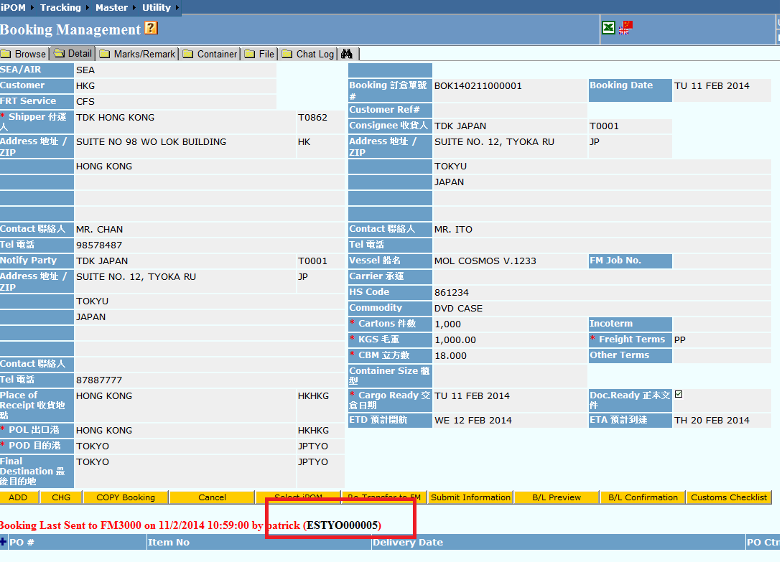
Booking status and shipment status
If the booking is being processed, you can see the official SO number. Click to the number and check the current shipment status

Slide 29
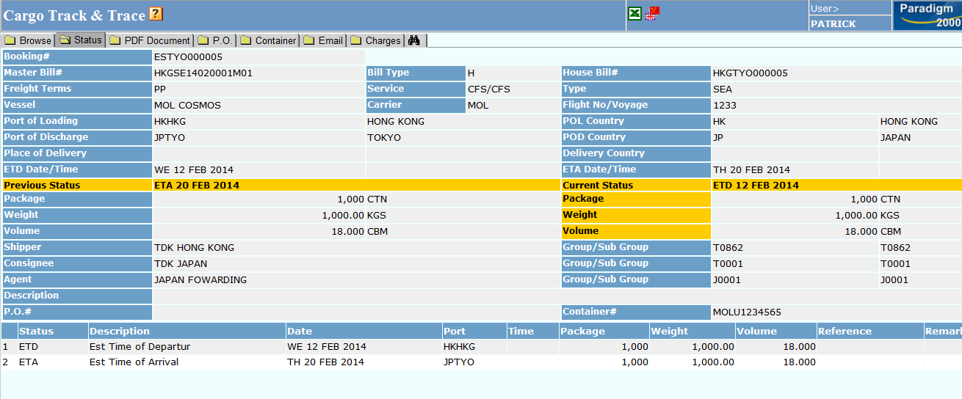
Cargo Status
The current shipment status is found
Click PDF Document and check for other documents images

Slide 30
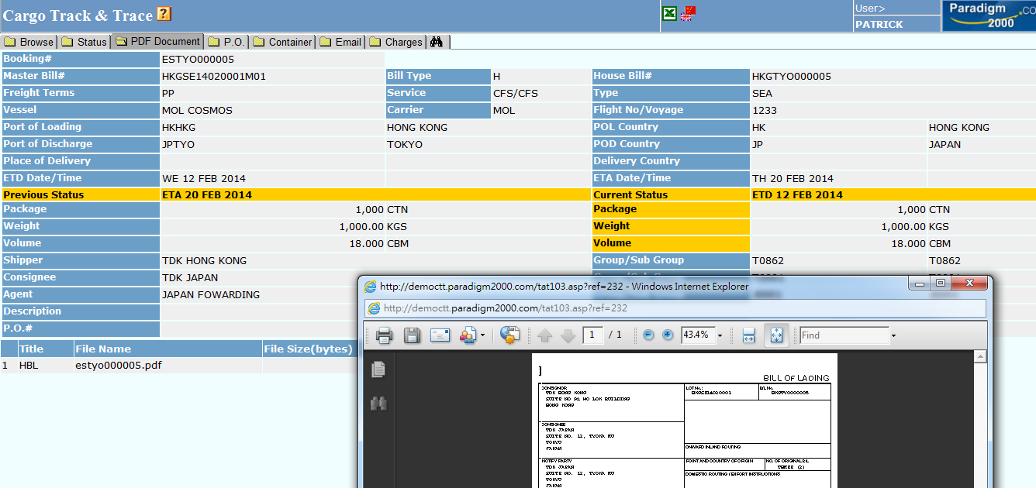
PDF Document
You can see if there are documents for you to check.
Click to the filename and open the file

Slide 31
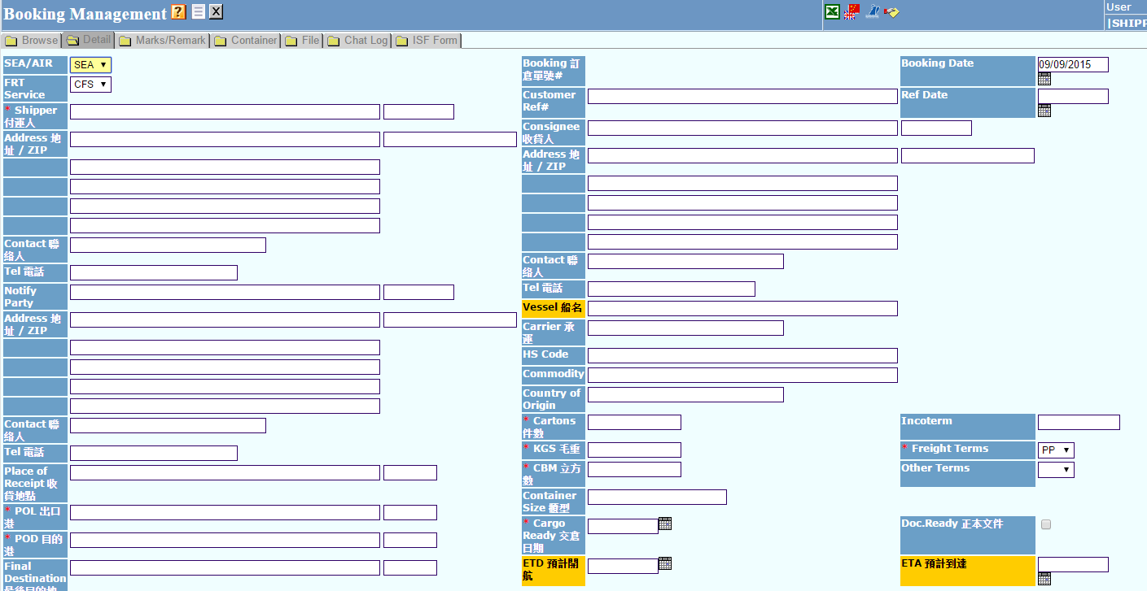
E-booking to FM3K
Shipper will have their ID to log into the system
Shipper needs to input the Cartons, KGS, CBM and POL, POD, Freight terms and Cargo ready date
Once press the button [Confirm], a booking number will be generated.

Slide 32
E-booking to FM3K
Shipper can continue to input the Marks and Remark information
The information will be shown for HBL Marks and Description

Slide 33
E-booking to FM3K
shipper can go back to the Detail screen and press [Submit information]
Create chat log, shipper may input free texts for leaving messages

Slide 34
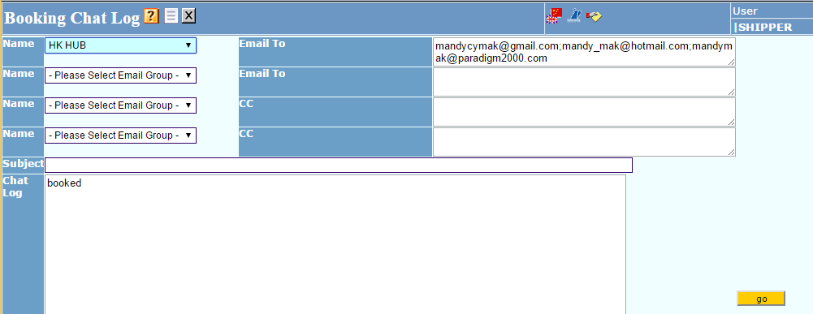
E-booking to FM3K
Shipper can send email by pressing the blue bulb
Press [go], Email will be sent out. It will trigger to send another copy to the customer service department if preset is done

Slide 35
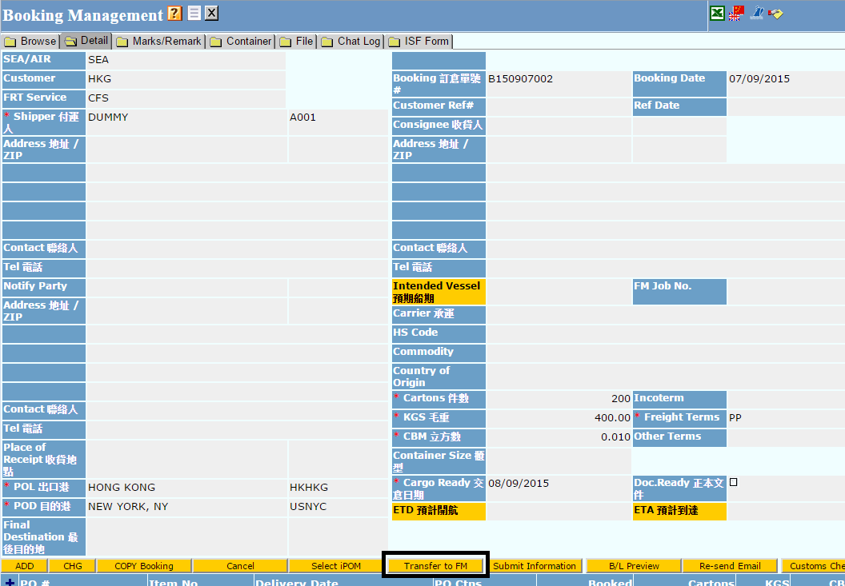
E-booking to FM3K
When the forwarder receives the booking, he can check the detail information and press the button [Transfer to FM3000]
Press [OK] to confirm the transfer.

Slide 36
E-booking to FM3K
Then in FM3000, the booking can be found in the S/O
The system will get the Booking Number from FM3K immediately, Operation Team will then be alert.

Slide 37
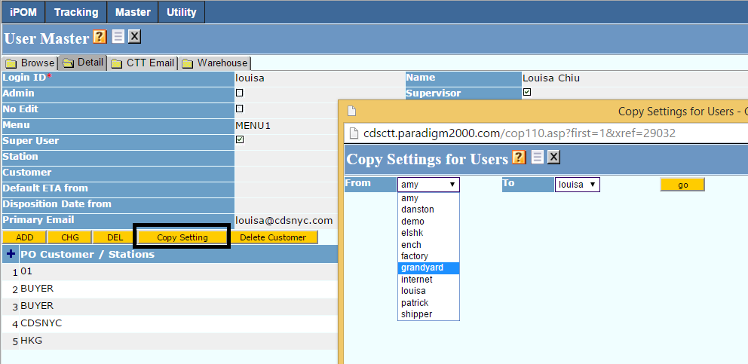
IT Administrator Security Master – User Account
User Account Set Up. You can use [Copy Setting] but make sure security is set up for specific vendor or customer code.

Slide 38
Security Master – User Account
Caption | Definition
Login ID | Login ID in the system
Name | Login Name in the system
Password | Password used to valid the login id
Admin | When Create or Update booking record, system will send email to this user.
Supervisor | Allow to press Transfer to FM3K in eBooking, Allow to update the booking record of the shipper with valid codes
Expire | Expiry date of the login ID
No Edit | Allow to view the record only
Lang | Language setting for Menu Bar
Start | The first program that the user will see in the system after login
Menu | Menu bar the user can access
Color | Current it is default to XDOCK
Super User | If it is tick, the user can see all the CTT records without checking
Booking Shipper Code | This is where we store the booking record and have the validation set on to the access right. If the Menu is Shipper and it is blank it will default to login ID.
Primary Email | Email of the login user
PO Customer / Station | This will check the PO File of CUSTOMER. User can select those customer’s PO.
Vendor | This will verify the vendor code of the PO File. If it is leaving blank, it means all vendor.

Slide 39
Master File
FM Customer Profile
IT Administrator should maintain the master file. If there will be new shipper onboard, please make sure the FM Customer Profile is input.
Country Profile (Forwarder)
This is where we store the email address of the Loading Port office and Destination Port office. If user input the FM Customer Code (Subgroup Code) in this function, that customer code only allowed to check that POD’s CTT record.

